Slide 2
Concerns
Exams / Assessments
'Catch up'
Keeping safe
Too many people
Nervous about seeing everyone
Wearing a mask all day

Slide 3
Routine
Routines promote healthy habits.
For people with busy schedules, daily plans can promote healthy lifestyle habits. Simple changes like packing your bag the evening before school or packing a more balanced diet will help you feel more organised.
Set aside time to focus on your physical health.
Reduce time on social media.

Slide 4
Healthy Eating
Eat regular meals
Do not skip breakfast
Do not get dehydrated
Eat a balanced diet and remember to:
a) include high fibre, starchy carbohydrates
b) Eat lots of fruit and veg
c) Eat more fish
d) Cut down on saturated fat and sugar
e) Eat less salt
Get active and maintain a healthy weight

Slide 5
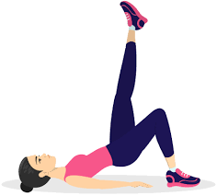
Exercise
Physical activity has a huge potential to enhance our wellbeing.
Even a short burst of 10 minutes' brisk walking' increases our mental alertness, energy and positive mood.
Participation in regular physical activity can increase our self-esteem and can reduce stress and anxiety.

Slide 6
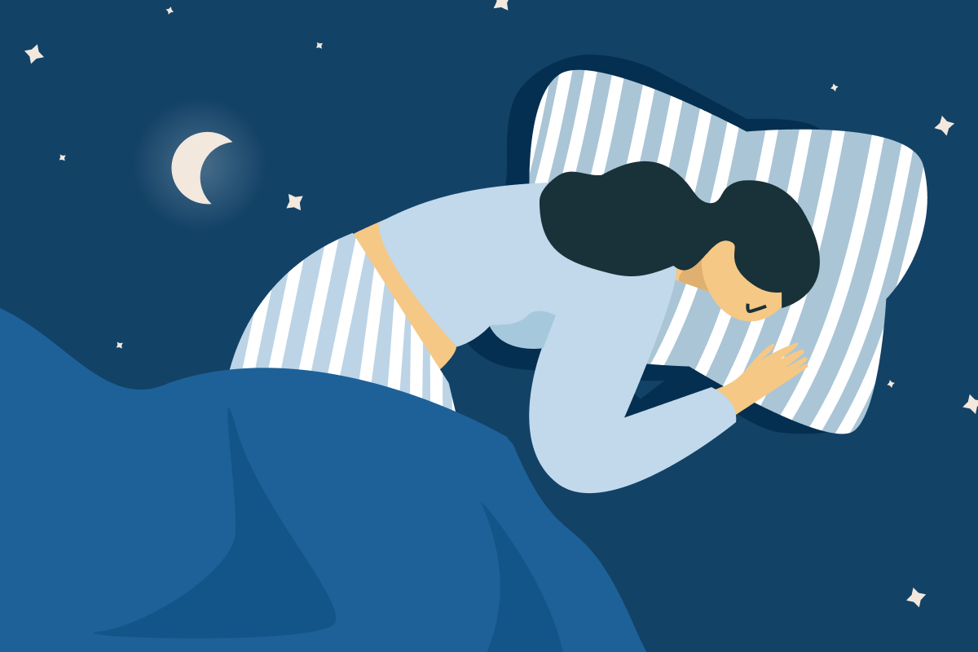
Sleep
It is important to get a good night’s sleep.
Few people manage to stick to strict bedtime routines.
Sleep at regular times - This programmes the brain and internal body clock to get used to a set routine.
Most adults need between 6 and 9 hours of sleep every night. By working out what time you need to wake up, you can set a regular bedtime schedule.
It is also important to try and wake up at the same time every day.

Slide 7
Winding Down
Winding down is a critical stage in preparing for bed. There are lots of ways to relax:
a warm bath (not hot)
writing 'to do' lists for the next day
relaxation exercises, such as light stretches, help to relax the muscles
listening to relaxing music
reading a book or listening to the radio relaxes the mind by distracting it
using apps such as ‘CALM’
avoid using smartphones, tablets or other electronic devices for an hour or so before you go to bed as the light from the screen on these devices may have a negative effect on your sleep pattern

Slide 8
Anxiety
Anxiety is a feeling of unease, such as worry or fear, that can be mild or severe.
Everyone has feelings of anxiety at some point in their life. For example, you may feel worried and anxious about sitting an exam, having a medical test or job interview.
During times like these, feeling anxious can be perfectly normal.
But some people find it hard to control their worries. Their feelings of anxiety are more constant and can often affect their daily lives.

Slide 9
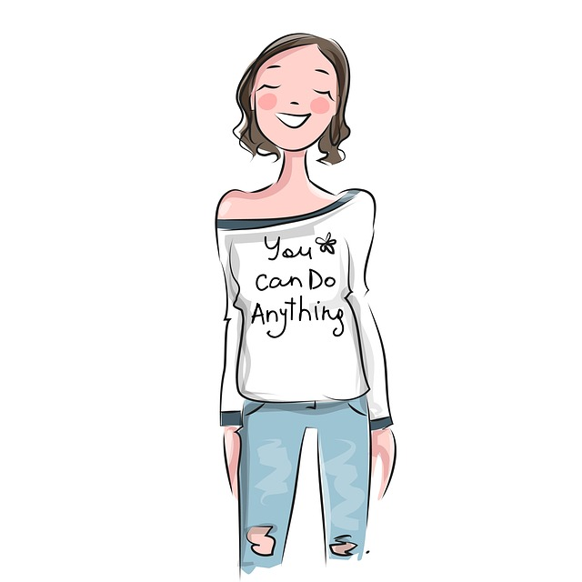
Coping Strategies
Take a time-out
Limit caffeine
Take deep breaths
Count to 10 slowly
Do your best and accept that this is ok
Accept that you cannot control everything
Welcome humour and have a laugh!
Maintain a positive attitude
Learn what triggers your anxiety
Talk to someone

Slide 10
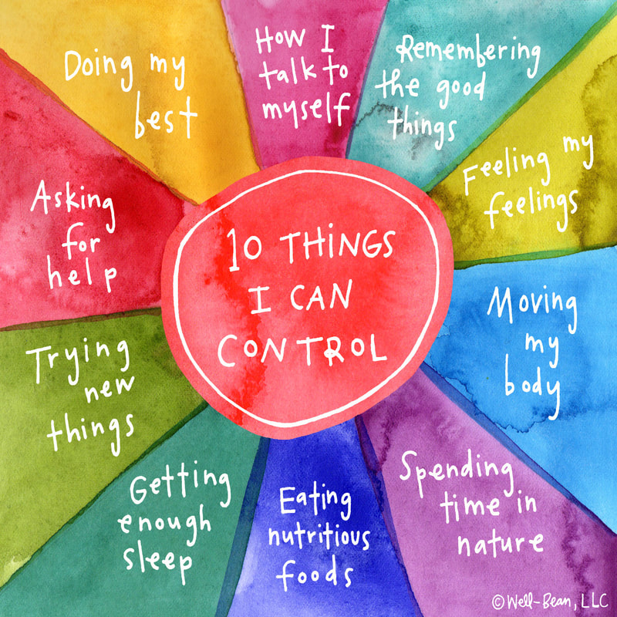
Remember
You cannot control everything...
But, here are 10 things that you can control....

Slide 11
Sources of Support
Family
Friends
School Staff
Child Line

Slide 12
Take 5

Slide 13
See you on Monday 22 March

